Slide 1
Blood Pressure (BP) Basics
Stephanie Marthey, bsn, rn

Slide 2
High Blood Pressure - The “Silent Killer”
It affects almost half of all adults in the U.S.
Patients rarely experience the symptoms of high BP until it’s too late.
Once symptoms present themselves, the damage has already been done.
Prolonged high blood pressure increases your risk of heart attack, stroke, and heart failure.
It’s important to get your BP checked routinely to catch any changes.

Slide 3
How Does it Work?
When your heart beats, it creates pressure inside your arterial walls. In between beats that pressure decreases/relaxes.
If there is damage to the artery walls, it causes them to narrow or become rigid.
Once that damage has happened, it causes resistance to the blood flow and your heart works harder and beats faster to pump blood throughout your body. This increases the workload of your heart which can result in chronic high blood pressure or hypertension.

Slide 4
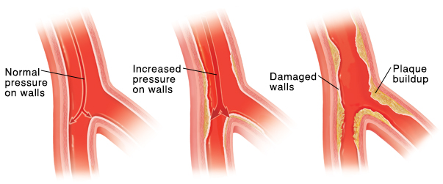
Blood pressure is the force of blood pushing against your arterial walls.

Slide 5
Risk Factors for Hypertension
Increasing Age
Alcohol Use
Family History of High BP
Race – African Americans are at a higher risk
Sedentary Lifestyle
High Salt Diet
Smoking
Stress
Overweight
Existing Medical Conditions Such As: Diabetes, Gout, Kidney Disease, Depression

Slide 6
The CDC states there are 1.1 million visits to the ER each year for high blood pressure.

Slide 7
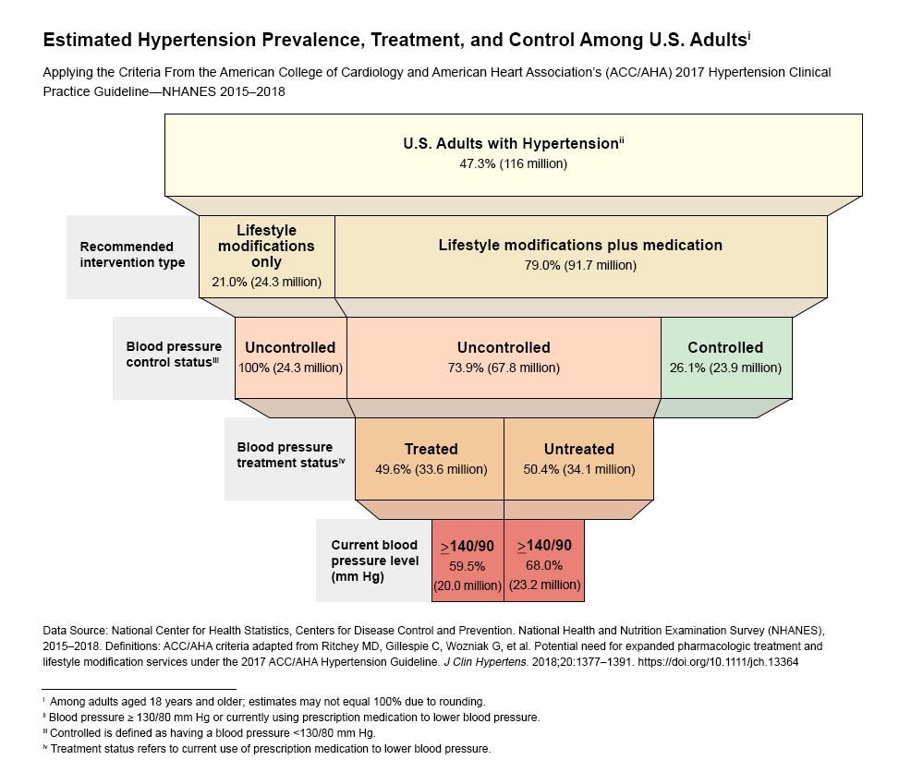
BP Stats

Slide 8
What do the numbers mean?
BP is measured by two numbers:
Systolic (top): when the heart contracts
Diastolic (bottom): when the heart relaxes
Normal BP: Less than 120/80
Elevated BP: 120-129/80
Stage 1 High BP: 130-139/80-89
Stage 2 High BP: 140 or higher/90 or higher
Hypertensive Crisis: 180 or higher/120 or higher

Slide 9
Hypertensive Crisis
Causes:
Forgetting to take your BP meds
Abruptly stopping your daily prescribed cardiac meds
Medication interactions
Tumor(s) of the adrenal glands
Symptoms
Anxiety
Blurred vision
Chest pain
Confusion
Nausea
Vomiting
Unresponsiveness
Seizures
Severe headache
Shortness of breath

Slide 10
Hypertensive Crisis
If you have a blood pressure reading of 180/120 or higher, you are experiencing:
Chest pain
Shortness of breath
Stroke symptoms such as:
Numbness
Tingling
Trouble speaking
Changes in vision
You need to call 9-1-1 or seek emergency medical services.

Slide 11
Don’t Panic!
Having one high blood pressure reading does not mean you have chronic high blood pressure.
Your healthcare provider would need multiple readings over days or weeks to accurately diagnose hypertension and then discuss various treatment options.

Slide 12
Treatment Options
Lifestyle Changes:
Low-fat, low sodium diet with whole grains, vegetables, and fruits
Regular exercise
Maintaining a healthy weight
Reducing or eliminating alcohol and caffeine
Not smoking
If lifestyle changes don’t lower your blood pressure, your healthcare provider can discuss medications to treat you.

Slide 13
Medicinal Treatment Options
Oral medications such as:
Thiazide Diuretics
These help the body get rid of extra salt to help control BP.
ACE Inhibitors (Angiotensin-Converting Enzyme)
Angiotensin causes arteries to narrow, thus this medication helps prevent the body from making this chemical, which leads to the blood vessels to relax.
Angiotensin II Receptor Blockers
This med blocks the effect of angiotensin and its reaction it has on blood vessels, which prevents constriction.
Calcium Channel Blockers
Calcium causes the smooth muscle cells in the heart to contract stronger, so this medication blocks that resulting in reduced contraction force.
Beta Blockers
These meds reduce the force of contractions in the heart, as well as causing the heart to beat slower.

Slide 14
If you are taking daily medications to treat your BP, you should not stop taking them without talking to your prescribing doctor.
If you are experiencing side effects, you should also contact your doctor for an evaluation.

Slide 15
Make sure you are checking your blood pressure periodically to help avoid missing any unseen damage that may be happening to your cardiovascular system.

Slide 16
References:
www.uhhospitals.org
www.heart.org
www.mayoclinic.org

