Slide 1
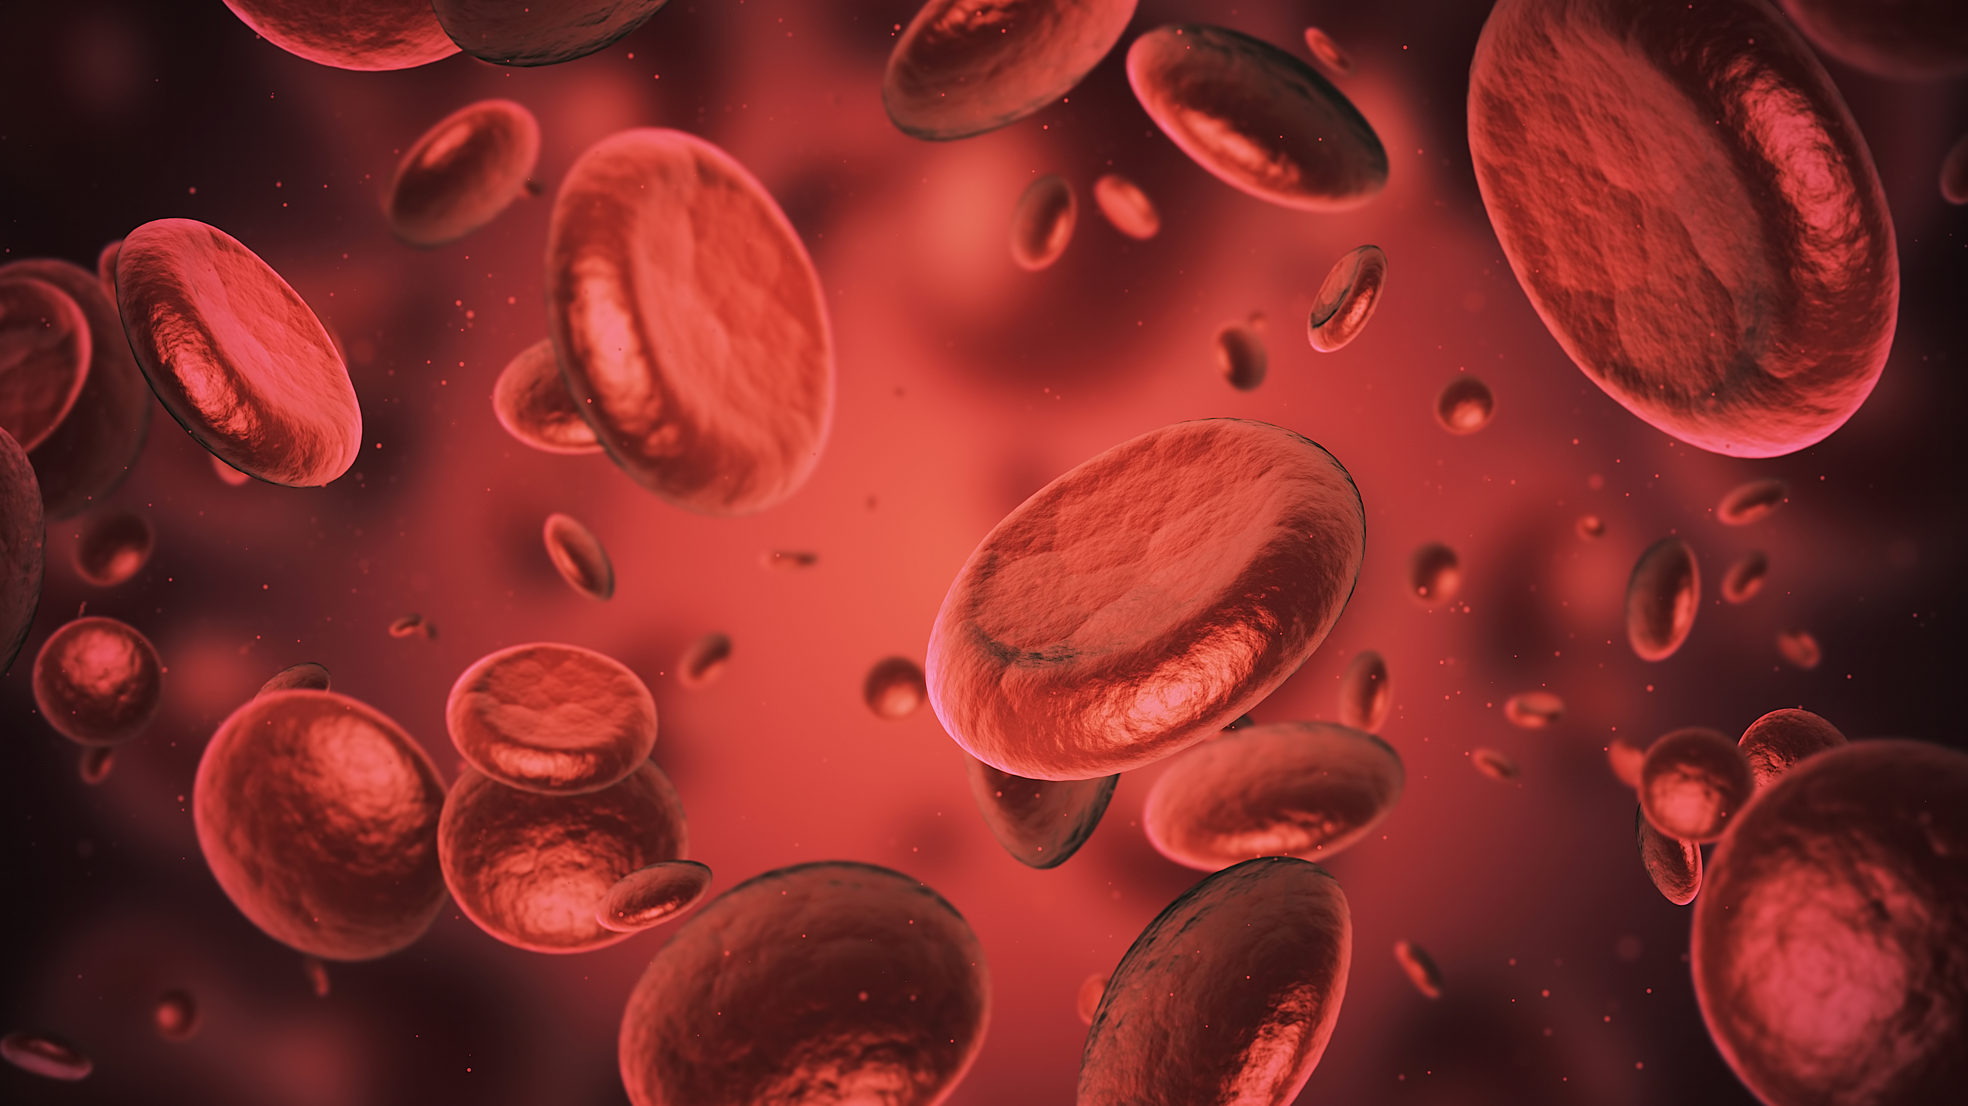
Blood Types/Structure/transfusions
By: Stephanie Marthey, BSN, RN

Slide 2
Blood is made up of red blood cells, white blood cells and platelets in a liquid (plasma)

Slide 3
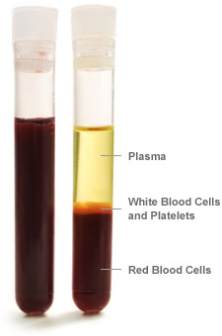
Red Blood Cells carry oxygen and remove waste products
White blood cells help fight infections in your body
Plasma is the liquid portion of blood
Platelets help your blood clot when needed

Slide 4
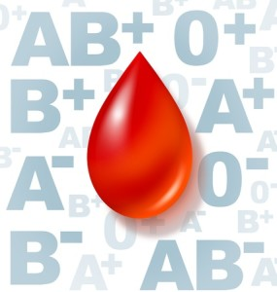
So, What’s your type?
There are four main blood groups:
A, B, AB, O
Blood types vary between individuals
Each person has a specific structure

Slide 5
Blood types are also classified by whether they carry a protein called Rh factor.
If your blood carries this protein, it’s considered positive and if it doesn’t carry it, then it’s considered negative.

Slide 6
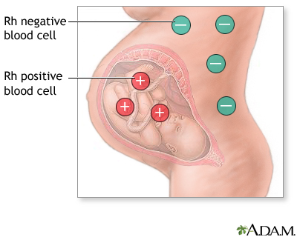
Rh factor
Rh positive is more common than Rh negative
If a woman is Rh negative, it can affect her pregnancy
Rh incompatibility happens when the mother is Rh negative, and the unborn baby is Rh positive
This isn’t an issue for the first pregnancy, but subsequent pregnancies can develop problems
The mother’s blood cannot come in contact with the baby’s blood
This could produce antibodies that can damage the baby’s red blood cells resulting a life-threatening anemia where the red blood cells are destroyed faster than what they can be produced.

Slide 7
Which results in 8 common blood types
A+
A-
B+
B-
AB+
AB-
O+
O-

Slide 8
Where do you get your type?
mom
You!
Dad

Slide 9
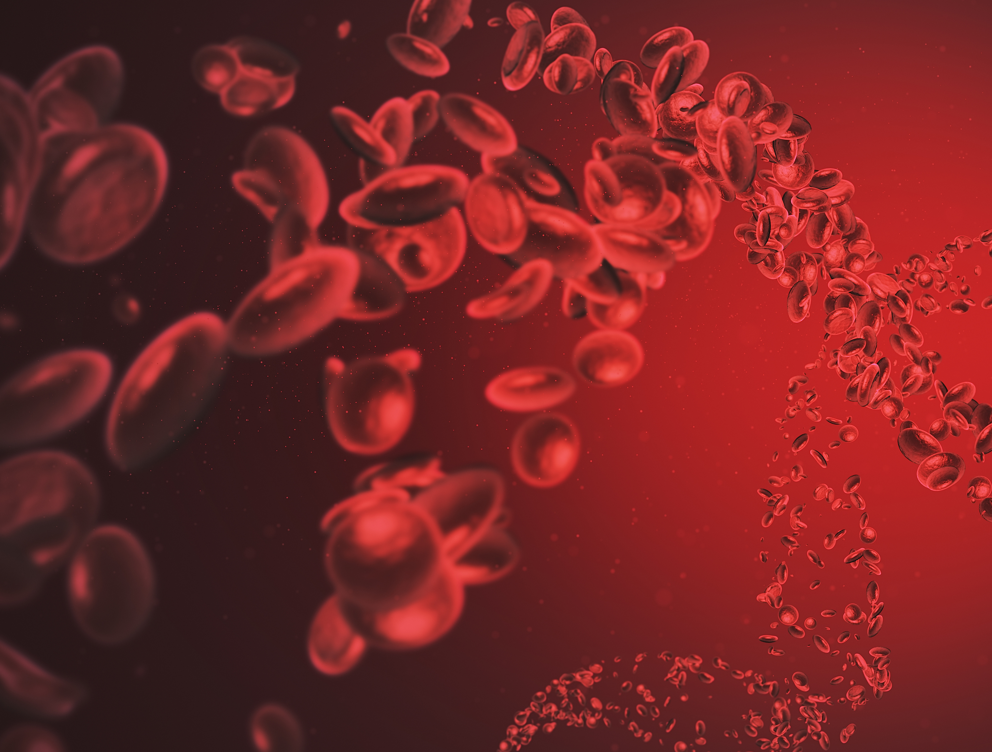
A lot of possibilities
Just like you inherited your eye color from your parents, that’s also how you get your blood type.
However, there are quite a few possibilities, so you may not have the exact blood type as what your mom or dad has.

Slide 10
The most common blood type in the United States is O+
The least common blood type in the United States is AB-
O- blood has the highest demand

Slide 14
Why does all this matter?
It’s important to know blood types when donating and receiving any blood products.
Not all blood types are compatible.
Receiving blood from a donor that contains antigens/proteins that your blood doesn’t carry or recognize, could result in a life-threatening situation.

Slide 15
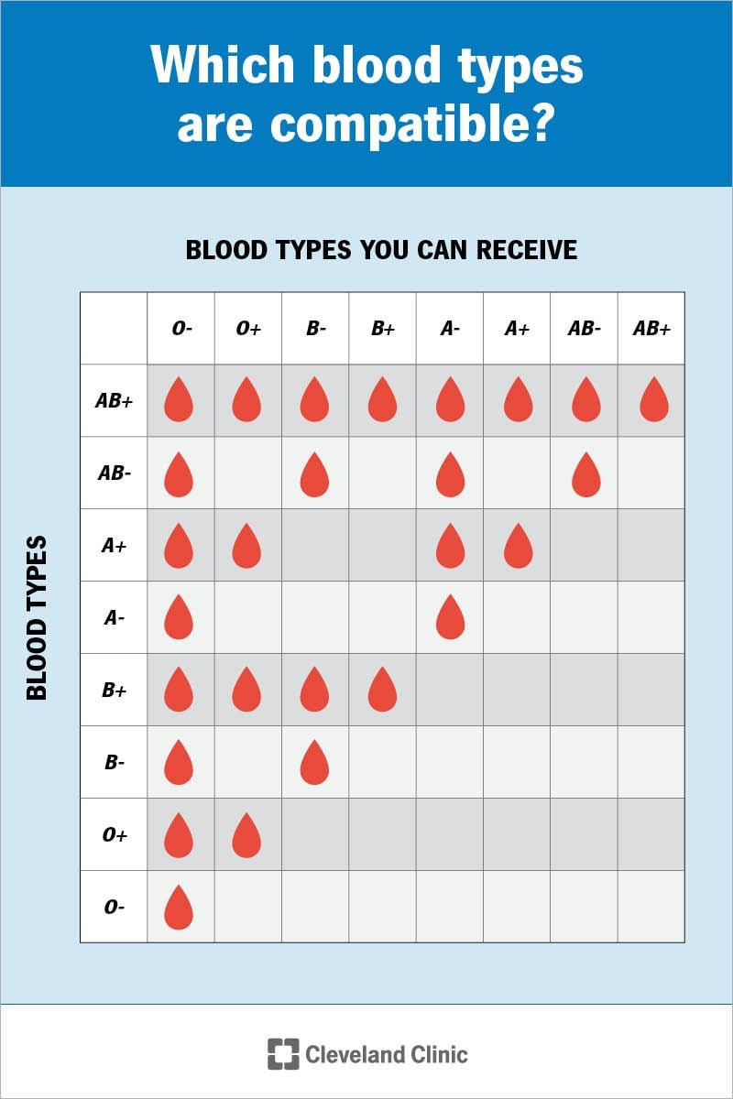

Slide 16
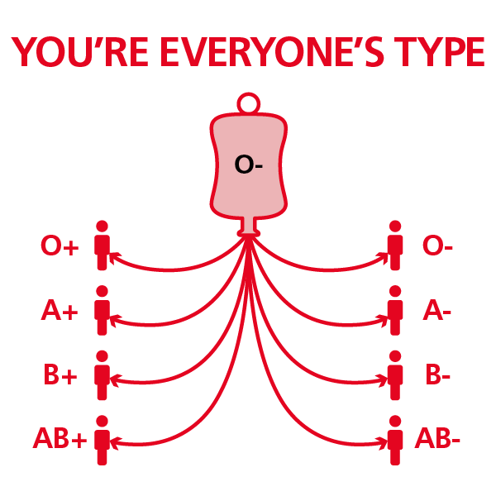
O- blood is considered the universal donor. Anyone, regardless of their blood type, can receive this type of blood safely.
O- blood is used in emergency situations when there isn’t time to find out what the person’s blood type is.

Slide 17
AB+ is considered the universal recipient because a person with this blood type can safely receive any blood type without having a severe immune reaction.

Slide 18
What happens if you receive an incompatible blood type?
It can cause a severe, life-threatening reaction.
Your immune system reacts as if those donor cells are foreign invaders and will attack them.
The donated blood turns useless in a person's body and can launch a massive immune system and clotting response that can result in:
-Shock
-Kidney failure
-Circulatory collapse
-Death

Slide 19
Blood Transfusion Risks/Side-effects
There are risks associated with compatible blood transfusions, too.
Some of these risks/side-effects happen immediately as the transfusion starts, while others can be delayed days, weeks, or up to a month.

Slide 20
Most common signs and symptoms:
Fever
Chills
Hives
Itching
Trouble Breathing
Low Blood Pressure
Bloody Urine
Sense of Impending Doom (like something bad is about to happen to them)

Slide 21
What safeguards are in place to avoid these issues?

Slide 22
type & cross testing done
This is a blood test that is performed prior to blood donation (for non-emergent situations)
Type is performed to determine the type of blood from the donor and the recipient
Cross match is done by taking a small amount of the donor’s blood and mixing it with the recipient’s blood. This is examined under a microscope to determine if they are compatible.

Slide 23
Strict protocols are in place for blood & blood product(s) transfusions
Some of these include:
Must have an order from physician to transfuse blood or blood products
Two RN’s must verify patient information, as well as specifics for donated blood and inspect blood/blood product(s) that will be used
Rigorous protocols for patient vital signs, set up, etc.
Nurse stays with patient and monitors patient and patient’s vital signs for specific timeframe

Slide 24
What are donated blood & Blood products used for?
It’s used to treat patients with medical conditions like:
Anemia
Cancer
Blood Disorders
Surgery
Severe Blood Loss

Slide 25
Donated blood is typically separated into different parts
Donated blood is made up of numerous components such as:
Red Blood Cells
Platelets
Plasma
Separating whole blood into components above enables patients to receive what they need.
Most blood transfusions are not whole blood. Separating the components allows for the specific need to be given.

Slide 26
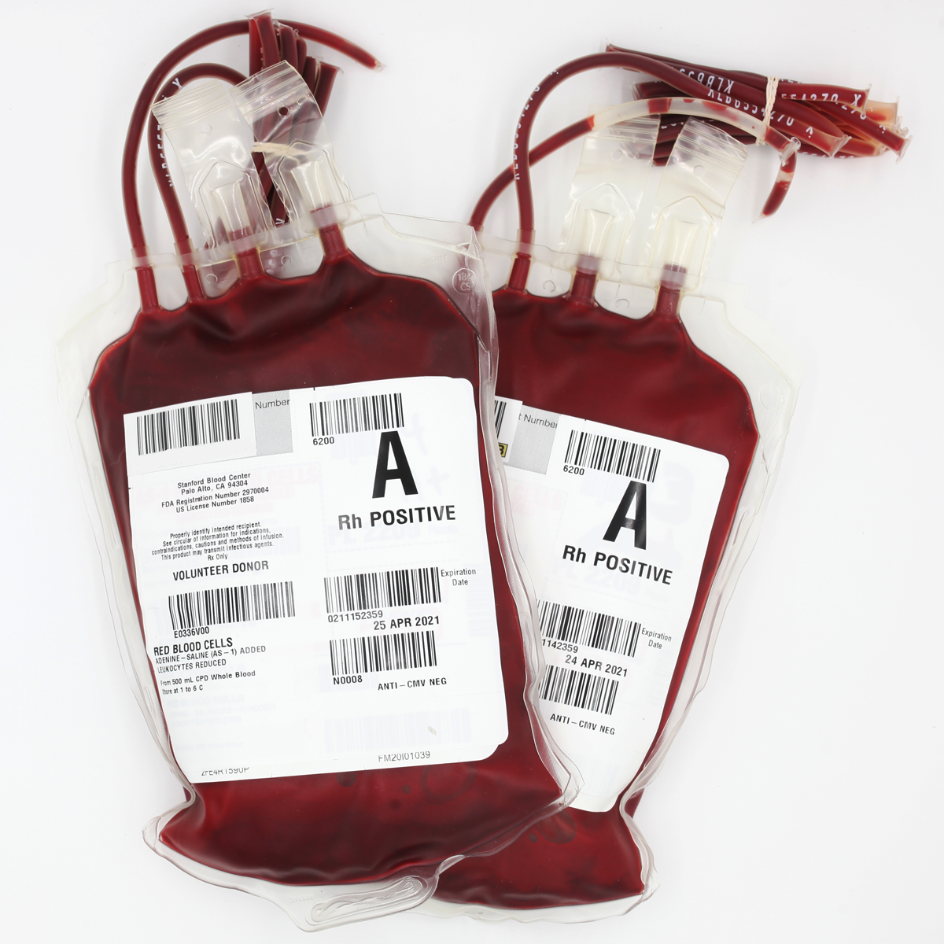
Red Blood Cells
Used for:
Severe trauma
Bleeding ulcers
Major surgeries with large amounts of blood loss
Sickle Cell Anemia
People who lose significant amount of blood
Red blood cells are indicated in more than 70% of all transfusions!

Slide 27
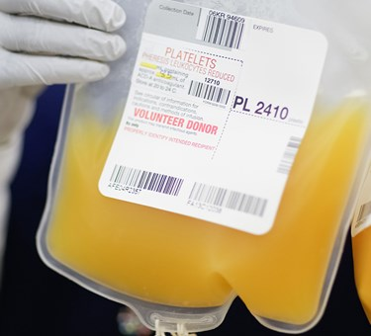
Platelets
Used to:
Treat or prevent bleeding in patients with platelet disorders
Prior to specific procedures to prevent bleeding
Patients who do not have enough of their own platelets
Treat side-effects of cancer treatments
Donated platelets must be used within 5 days!

Slide 28
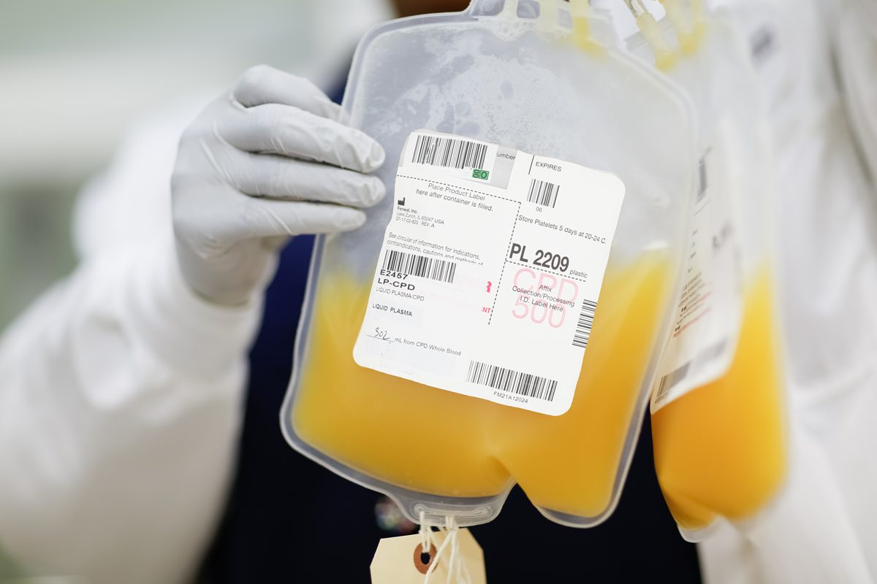
Plasma
Used for:
Severe trauma
Burn
Shock
Adults & children with cancer
Liver or Clotting Disorders
Donated plasma can be frozen and stored for up to a YEAR!

Slide 29
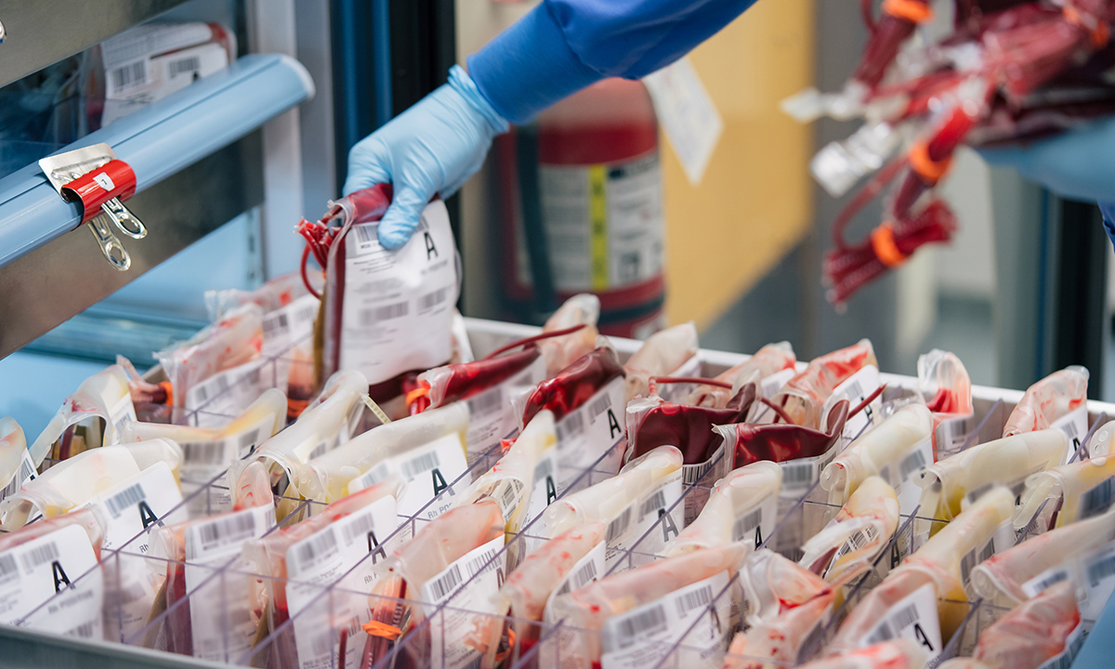
Interested in seeing a short clip of a blood transfusion?
Click the link to see for yourself: What does a Blood Transfusion look Like? - YouTube

Slide 30
Interested in donating blood?
Will-Burt is hosting its second onsite blood drive on Thursday, August 31st!
Keep an eye on the TV’s and my blog for more information and sign ups.

Slide 31
References
www.redcross.org
www.mayoclinic.org
www.ccf.org
www.ncbi.gov
www.medicalnewstoday.com

