Slide 1
Colon Cancer & Screenings
Stephanie Marthey, BSN, RN

Slide 2
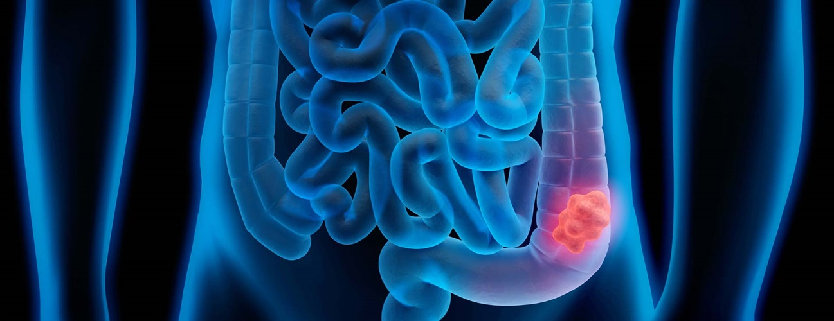
What is Colorectal Cancer?
A disease where the cells in the colon or rectum grow abnormally and out of control. In some cases, polyps can form in your colon or rectum and can become cancerous.

Slide 3
Screening Purpose
Finding precancerous cells before they turn into cancer
Most malignancies (cancerous tumors/lesions) do not produce symptoms until late stages
Diagnosing cancer in its early stages for optimal treatment/cure

Slide 5
Who & When?
Routine screening should begin at age 45
Some people may need to be screened earlier than age 45 if any of the following apply to you:
Inflammatory bowel disease (Crohn’s Disease or ulcerative colitis)
Personal or family history of colorectal cancer or polyps
Genetic syndrome such as Lynch Syndrome
If you have questions about when you should be screened for colorectal cancer, you should make an appointment with your primary care doctor to discuss.

Slide 6
Lifestyle Risk Factors
Sedentary lifestyle
Diet low in fruits and vegetables
Low-fiber/high-fat diet
Obesity
Alcohol consumption
Tobacco use
Aging

Slide 7
Common Symptoms of Colorectal Cancer
Change in bowel habits
Blood in your stool
Diarrhea, constipation, or feeling as though your bowels do not empty all the way
Abdominal pain, aches, cramps that do not go away
Weight loss that is unexplained/unplanned
If you are experiencing any of these symptoms, you should talk to your doctor.

Slide 8
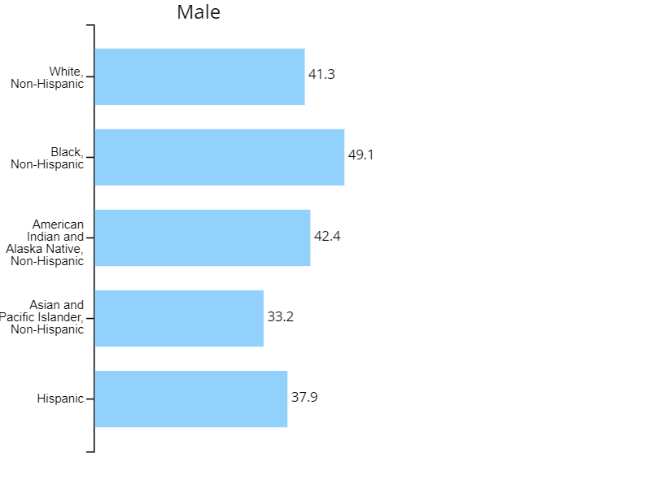
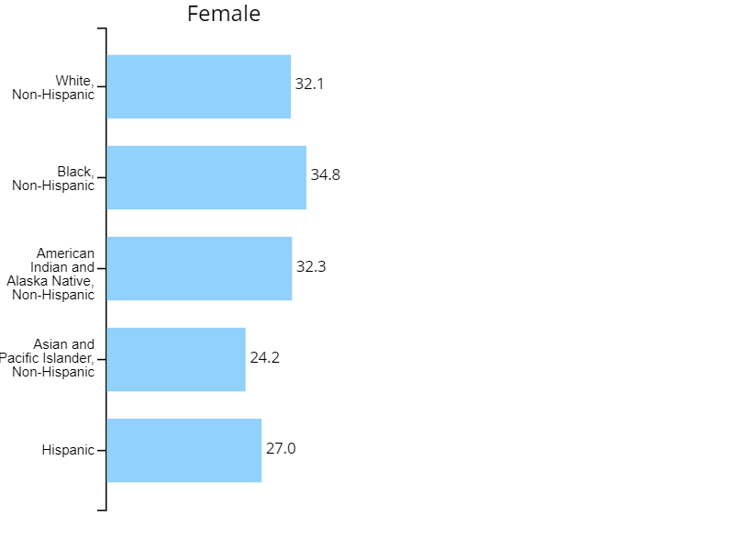
Rate of New Cancers By Sex and Race and Ethnicity
Colon and Rectum, United States, 2019
Rate per 100,000 people
Source - U.S. Cancer Statistics Working Group. U.S. Cancer Statistics Data Visualizations Tool, based on 2021 submission data (1999-2019): U.S. Department of Health and Human Services, Centers for Disease Control and Prevention and National Cancer Institute; https://www.cdc.gov/cancer/dataviz, released in November 2022.

Slide 9
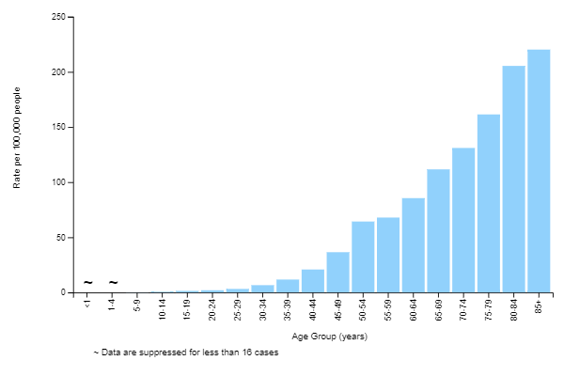
Rate of New Cancers By Age Group (years), All Races and Ethnicities, Both Sexes
Colon and Rectum, United States, 2019
Source - U.S. Cancer Statistics Working Group. U.S. Cancer Statistics Data Visualizations Tool, based on 2021 submission data (1999-2019): U.S. Department of Health and Human Services, Centers for Disease Control and Prevention and National Cancer Institute; https://www.cdc.gov/cancer/dataviz, released in November 2022.

Slide 10
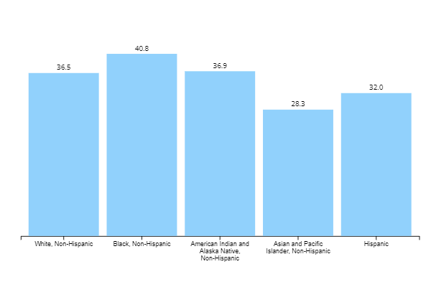
Rate of New Cancers By Race and Ethnicity, Both Sexes
Colon and Rectum, United States, 2019
Rate per 100,000 people
Source - U.S. Cancer Statistics Working Group. U.S. Cancer Statistics Data Visualizations Tool, based on 2021 submission data (1999-2019): U.S. Department of Health and Human Services, Centers for Disease Control and Prevention and National Cancer Institute; https://www.cdc.gov/cancer/dataviz, released in November 2022.

Slide 11
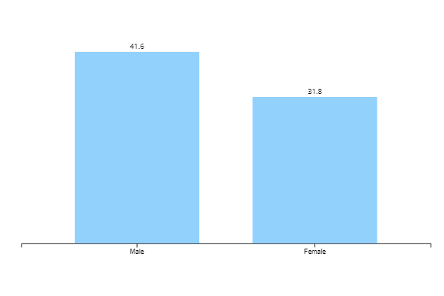
Rate of New Cancers, All Races and Ethnicities, Both Sexes
Colon and Rectum, United States, 2019
Rate per 100,000 people
Source - U.S. Cancer Statistics Working Group. U.S. Cancer Statistics Data Visualizations Tool, based on 2021 submission data (1999-2019): U.S. Department of Health and Human Services, Centers for Disease Control and Prevention and National Cancer Institute; https://www.cdc.gov/cancer/dataviz, released in November 2022.

Slide 12
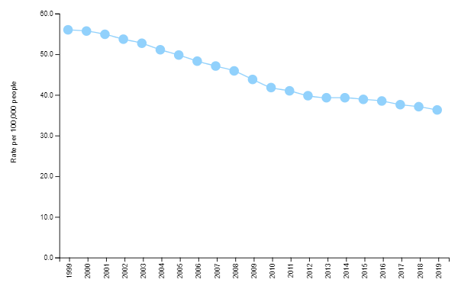
Annual Rates of New Cancers, 1999-2019
Colon and Rectum, United States
Source - U.S. Cancer Statistics Working Group. U.S. Cancer Statistics Data Visualizations Tool, based on 2021 submission data (1999-2019): U.S. Department of Health and Human Services, Centers for Disease Control and Prevention and National Cancer Institute; https://www.cdc.gov/cancer/dataviz, released in November 2022.

Slide 13
Current Rates
Colon and rectal cancers are trending down in large part to screenings and education. Early detection is key to catching cancer(s) in their beginning stages and most treatable stage.

Slide 14
Types of Screenings
Fecal Occult Blood Test
Sigmoidoscopy
Colonoscopy
Virtual Colonoscopy
DNA Stool Test

Slide 15
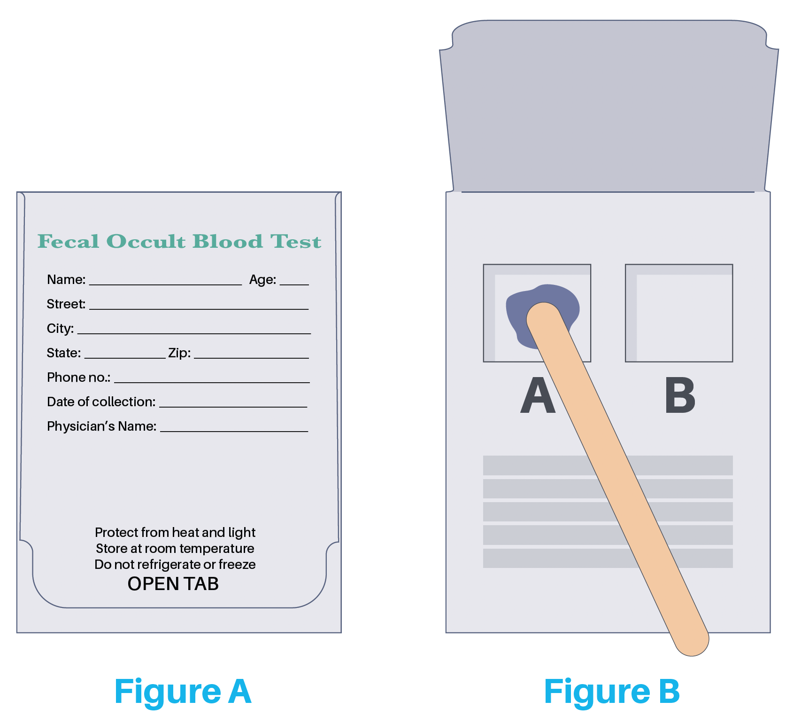
Fecal Occult Blood Test
Checks your stool for blood that can only be seen under a microscope
A small sample of stool is placed on a specific card or in a container and taken to a lab for processing

Slide 16
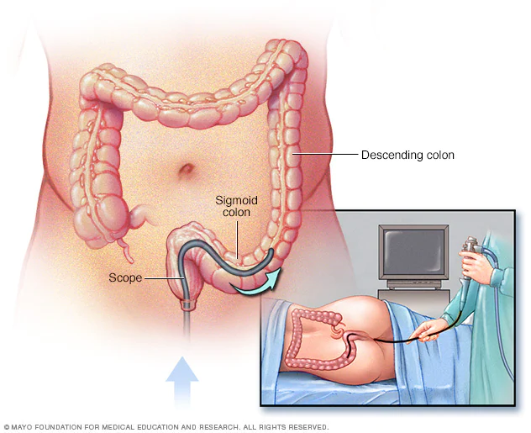
Sigmoidoscopy
A procedure that looks inside the rectum and lower colon (sigmoid)
A camera (sigmoidoscope) is inserted into the rectum into the sigmoid colon. It can remove polyps or take tissue samples for exam under a microscope.

Slide 17
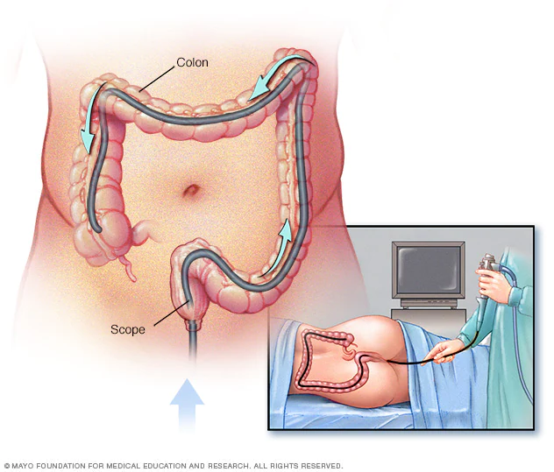
Colonoscopy
A procedure that looks inside the rectum and colon.
A colonoscope (special camera with a light) is used to view the rectum and entire colon. It can remove polyps and take tissue samples for microscopic review.
Will-Burt’s insurance covers a colonoscopy at 100%!

Slide 18
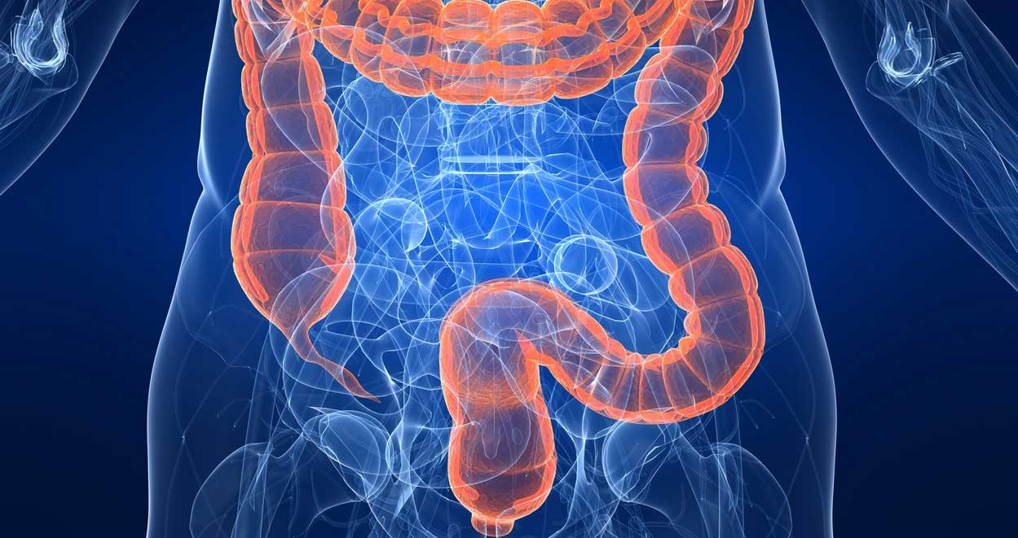
Virtual Colonoscopy
A procedure that uses a series of x-rays (computed tomography) that produces images of the colon.
A series of detailed images can show polyps or other unusual images on the inside surface of the colon.

Slide 19
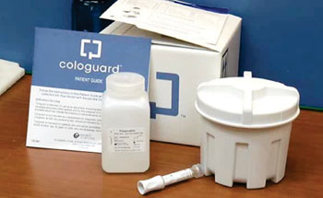
DNA Stool Test
A test that tests for signs of colon cancer by using a stool sample that is placed in a special container and mailed to a lab.
It tests for certain DNA changes that can indicate current cancer growth or future cancer risk, as well as testing for blood in stool.

Slide 20
Don’t delay in talking to your doctor about which screening is right for you and when. If you are experiencing unusual symptoms, you should reach out to your doctor for an appointment to discuss. If you have further questions or concerns, please do not hesitate to reach out to me in person or by phone at: 330-465-7997 or e-mail: wbnurse@willburt.com

Slide 21
References
www.cdc.gov
www.mayoclinic.org
www.cancer.gov
www.johnshopkinsmedicine.org

