Slide 1
Sleep
Stephanie Marthey, BSN, RN

Slide 2
Who needs sleep?
Adults? Children?
We all need to get proper sleep at night, but children need more sleep than adults.

Slide 3
How much do we need?
Adults should get at least 7 hours (or more) of sleep at night.
Children ages 6-18 should average 9-12 hours of sleep a night.

Slide 4
Benefits of Sleep for Children
According to a study conducted by the Mayo Clinic, children who get the recommended amount of sleep each night have better health, improved attention spans, behavior, learning, memory, mental and physical health, as well as better control over their emotions.

Slide 5
Benefits of Sleep for Adults
Improved Concentration/Productivity
Reduces your Risk of Diseases/Health Issues
Improves your Immune System
Boosts Memory
Supports Weight Management

Slide 6
Risks of Not Getting Enough Sleep
The Mayo Clinic’s study for adults who do not get enough sleep at night have a greater risk of:
Poor Overall Health
Weight Gain
Increased Risks for:
Diabetes
High Blood Pressure
Heart Disease
Stroke
Depression

Slide 7
Sleep Deprivation Risks
Affects your overall cognitive abilities (memory, concentration, decision making, etc.)
Reduces your reaction time
Affects your emotions and your ability to control them

Slide 8
Sleep Stages
There are two phases of sleep that we experience:
Rapid Eye Movement (REM)
Non-rapid Eye Movement (Non-REM)
We rotate through these stages approximately every 80-100 minutes

Slide 9
Non-REM Sleep
This cycle of sleep has three stages:
Stage 1: transition from wakefulness and sleep
Lighter sleep/easily awakened, muscles start to relax, slow eye movements
Stage 2: asleep
Eye movements stop, slower brain waves
Stage 3: deep sleep
Mostly the first half of the night
Deep sleep, harder to wake up, muscles are relaxed, heart and breathing rates are slow

Slide 10
REM Sleep
One stage of sleep during this cycle
Your brain is active during this stage
Eyes move rapidly
Breathing, heart rate and blood pressure are irregular
Arm and leg muscles are temporarily paralized
Dreaming typically happens during this stage
This stage usually occurs later in the night
Colder temperatures decreases REM sleep

Slide 11
Aging Effects
Cells in the brain that promote sleep decline with age
Conditions like Alzheimer’s disease speeds up the loss of sleep cells in the brain
This affects your ability to stay asleep
Older adults typically sleep less and wake up earlier

Slide 12
Factors Affecting Your Sleep
There are many things that can affect your ability to get a good night’s sleep
Some of these include:
Stimulants: caffeine, pain relievers, decongestants, nicotine
People who suffer from chronic asthma or bronchitis
Psychological disorders such as: schizophrenia, bipolar, anxiety disorders
Hormones
Lifestyle factors like overeating or strenuous exercise right before bed
Sleeping environment

Slide 13
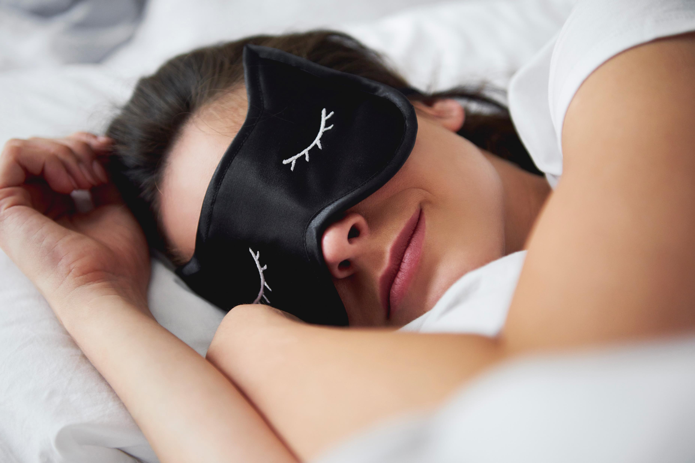
Tips for a Good Night’s Sleep
Stick to a schedule
Go to bed and wake up at the same time (or close to it) every day
Exercise at least 30 minutes a day
Avoid stimulants such as: nicotine and caffeine
Avoid alcohol before bed
Don’t eat a large meal right before bed
No napping after 3 p.m.
Give yourself time to unwind and relax before bed
Create a good sleeping environment (no distractions in your room such as bright lights, hot temperatures, noises, uncomfortable bed/pillow)

Slide 14
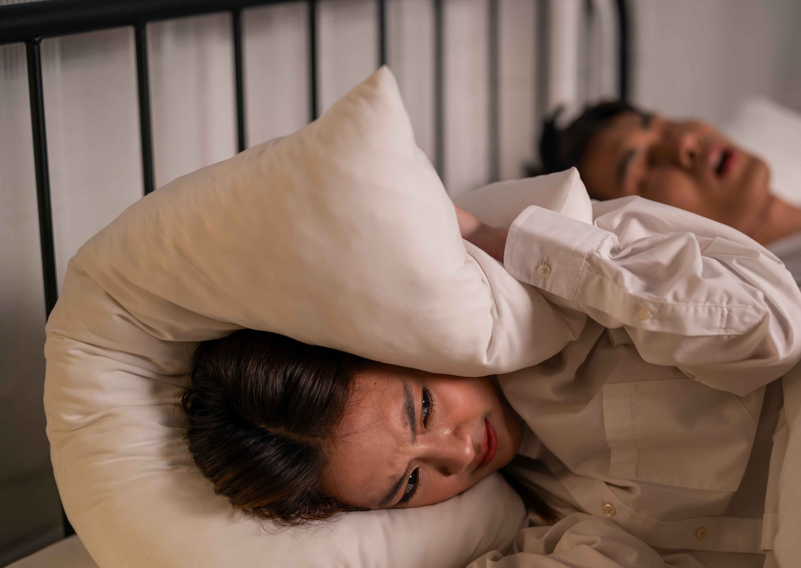
Sleep Disorders
More than 70 sleep disorders affect Americans
If you experience three or more of the following, you should talk to your doctor:
Takes you longer than 30 minutes to fall asleep
You’re awake multiple times throughout the night and struggle to fall back asleep
You wake up too early in the mornings
Not feeling rested after 7-8 hours of sleep
Falling asleep within 5 minutes of taking a nap or you fall asleep unexpectedly throughout the day
You snore loudly, snort, gasp or make choking sounds in your sleep
You stop breathing for short periods of time during your sleep
You require the use of stimulants to stay awake during the day
You feel paralyzed when you wake up
Your legs have a tingling/creeping/crawling feeling that are relieved by movement or massage in the evenings or when you’re trying to fall asleep

Slide 15
Sleep Apnea
Common condition that causes you to stop breathing during sleep
Caused by a blockage (obstructive sleep apnea) in your airway or because your brain can’t properly control your breathing
Results in a lack of oxygen (central sleep apnea) causing you to wake up enough to start breathing again
This puts stress on your heart and prevents restful sleep and other health effects

Slide 16
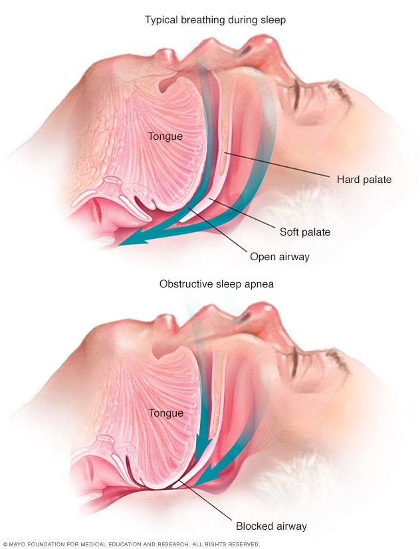
Obstructive Sleep Apnea
Can affect anyone at any age
Increased risk as you get older
Obesity/Overweight
More common in black, Hispanic, or Asian decent

Slide 17
Central Sleep Apnea
People who use opioid pain meds
Over the age of 60
Heart conditions such as: atrial fibrillation or congestive heart failure
Living in a high altitude

Slide 18
Complications of Sleep Apnea
Damage to your heart muscle
Arrhythmias such as atrial fibrillation
Sudden cardiac death where you experience a severe arrhythmia that stops your heart
Fatigue/drowsiness during the day that can cause you to fall asleep while driving your car or operating heavy machinery

Slide 19
What to do if you think you have sleep apnea?
Talk to your doctor about any of the symptoms you are experiencing
If sleep apnea is suspected, a sleep study will be conducted
Most are done at a medical facility, but can be performed at home

Slide 20
Possible Sleep Apnea Treatments
Non-medical treatments such as: weight loss, sleep aids, nasal sprays, medication changes
Ventilation devices
Mouthpieces
Nerve stimulators
Surgery
Medications

Slide 21
Conclusion
Sleep disorders can affect your quality of life and put you at risk for multiple health issues
If you think you may have a sleep disorder, you should contact your doctor to discuss any symptoms you may be experiencing
Practice good sleeping habits

Slide 22
References
www.mayoclinic.org
www.health.ucdavis.edu
www.heathline.com
www.nhlbi.nih.gov
www.clevelandclinic.org

